Slide 1
Concurrent Collections
Brandon Minnick
Code Traveler, LLC
Notes:
Welcome to concurrent collections. Everything in this section exists for one reason. The moment two threads write to the same collection, the collection you have used your whole career stops being correct.
Not slower, not noisier. Incorrect, and usually in the quietest way possible: missing data rather than an exception you can catch.
We will walk the four types in System.Collections.Concurrent, what each one replaces, and what each one costs you.
Then we will look at the two problems no concurrent collection can solve on your behalf: a counter that has to be incremented atomically, and a single field that two asynchronous methods both want to write.
You are about to fix all of that in a live market dashboard that quietly loses stock cards every time it renders.
https://learn.microsoft.com/dotnet/standard/collections/thread-safe/

Slide 2
Three Ingredients of a Race Condition Shared. Mutable. Unsynchronized.
Shared
More than one thread can reach it
Mutable
At least one of them writes
Unsynchronized
Nothing orders the reads against the writes
Notes:
A race condition needs all three of these at the same time. State that more than one thread can reach, at least one thread writing to it, and nothing imposing an order on those reads and writes.
That framing is useful because it gives you three separate escape hatches. Stop sharing the state and there is no race. Stop mutating it and there is no race. Or keep both and add synchronization, which is what the rest of this section is about.
Notice which one is cheapest. A local variable inside your parallel body is not shared, so it is free. An immutable record you build once and hand around is not mutable, so it is free too.
Reach for a concurrent collection when you genuinely need many threads writing to one place, not as a reflex. The fastest thread safe code is code with nothing to share.
https://learn.microsoft.com/dotnet/standard/threading/managed-threading-best-practices

Slide 3
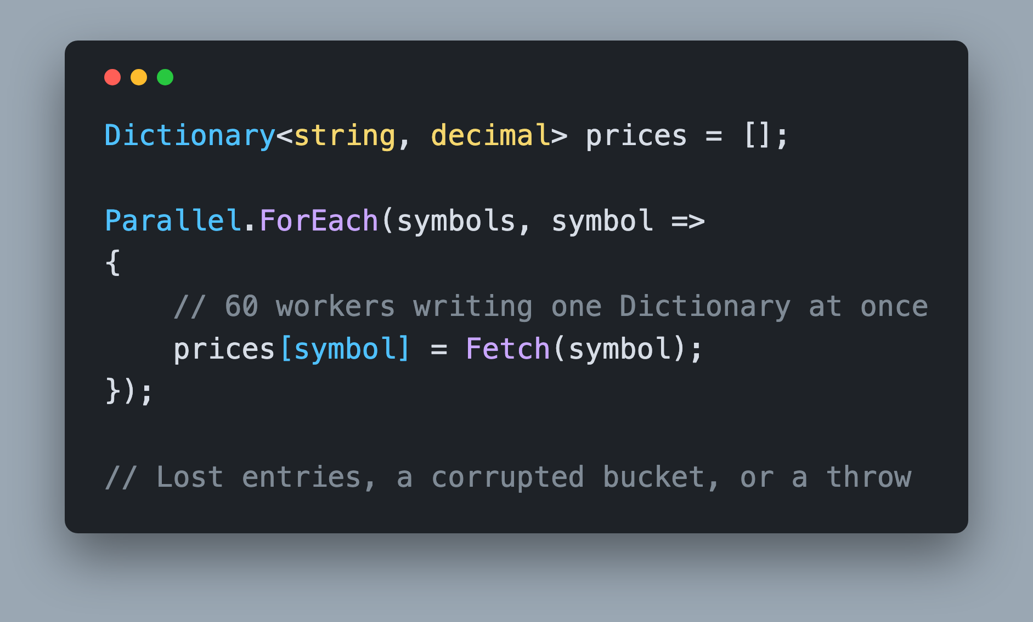
Dictionary<TKey, TValue> System.Collections.Generic
Requires one writer at a time
Or use `Lock` for each write
Notes:
This is the shape of the bug, and it is one loop long. Dictionary is fast precisely because it assumes a single writer.
Adding an entry can trigger a resize, which reallocates the internal arrays and rewrites every bucket chain. A second thread reading or writing during that window sees a half built structure.
You get one of three outcomes, and you do not get to choose which. The entry silently disappears, the internal state is corrupted so later lookups return nonsense, or the collection notices and throws. Silent loss is the common one and by far the worst.
List of T is the same story. Add writes to an internal array and grows it when it is full, so parallel Add calls overwrite each other's slots, and a torn list can even leave a null sitting in its backing array for your next LINQ query to trip over.
The documentation says it plainly: any instance members are not guaranteed to be thread safe.
https://learn.microsoft.com/dotnet/api/system.collections.generic.dictionary-2

Slide 4
System.Collections.Concurrent
Notes:
So what do you use instead? .NET ships four general purpose collections built for exactly this, plus BlockingCollection of T layered on top of them, and they have been in the box since .NET Framework 4.
They are not magic and they are not free, but each one takes a specific access pattern and makes it safe for many threads without you writing a single lock statement.
As we go through them, keep two questions in your head. First, what does this type replace, because each one maps cleanly onto something you already use. Second, how do I read the data back out, because that is usually what decides which one you want.
We will start with the one you will reach for most often, ConcurrentDictionary, and then look at the bag, the queue, and the stack.
https://learn.microsoft.com/dotnet/standard/collections/thread-safe/

Slide 5
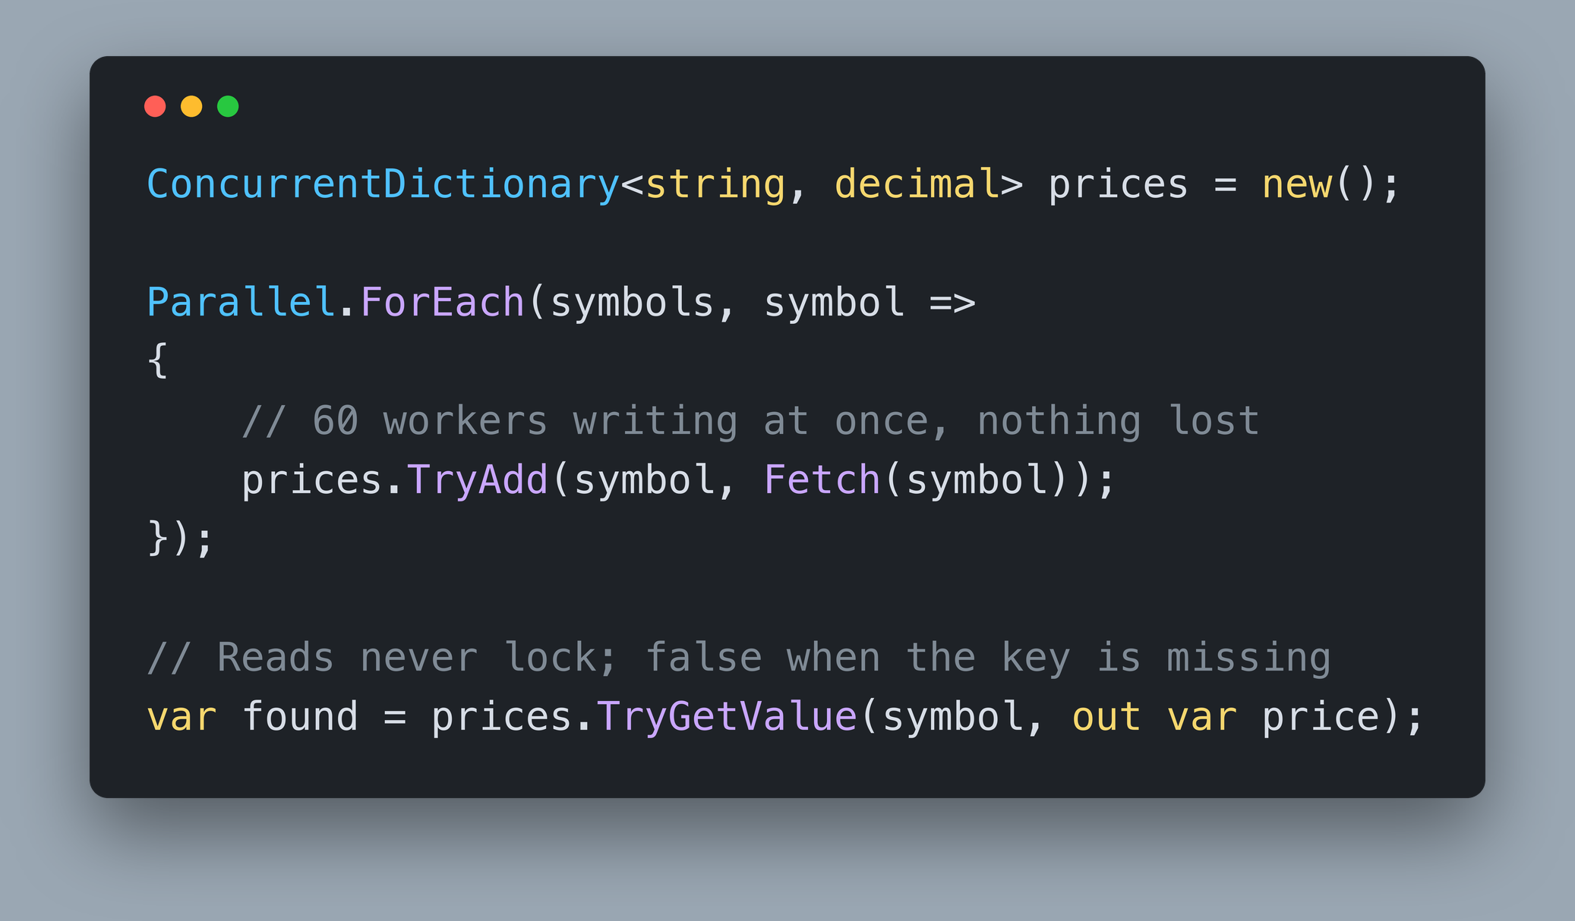
ConcurrentDictionary<TKey, TValue> System.Collections.Concurrent
Thread-safe collection of key/value pairs
Replaces `Dictionary<TKey, TValue>`
Lock-free Reads
Fine-grained locking for writes
A stripe of buckets per lock, not one global lock
`TryAdd`, `TryGetValue`, `TryRemove`, `TryUpdate`
Notes:
ConcurrentDictionary is the drop-in replacement for Dictionary, and it is the one you will use most. Reads take no lock at all. The collection is built so a reading thread always sees a consistent view, which makes it a very good fit for read heavy workloads like a cache.
Writes take a lock, but not one lock over the whole collection. The dictionary keeps a small array of locks, one per processor by default, growing to a cap of 1024, and each lock guards a stripe of buckets.
Two threads writing different keys usually land on different stripes and never wait for each other. Occasionally they collide on the same stripe and one waits. That is what fine-grained locking buys you, and it is why the type scales with your core count instead of against it.
Notice the method names. The Try prefix is everywhere because in a concurrent world every operation is a race with someone else. TryAdd can fail because another thread got there first, and TryRemove can fail because the key is already gone. Check the return value.
https://learn.microsoft.com/dotnet/api/system.collections.concurrent.concurrentdictionary-2

Slide 6
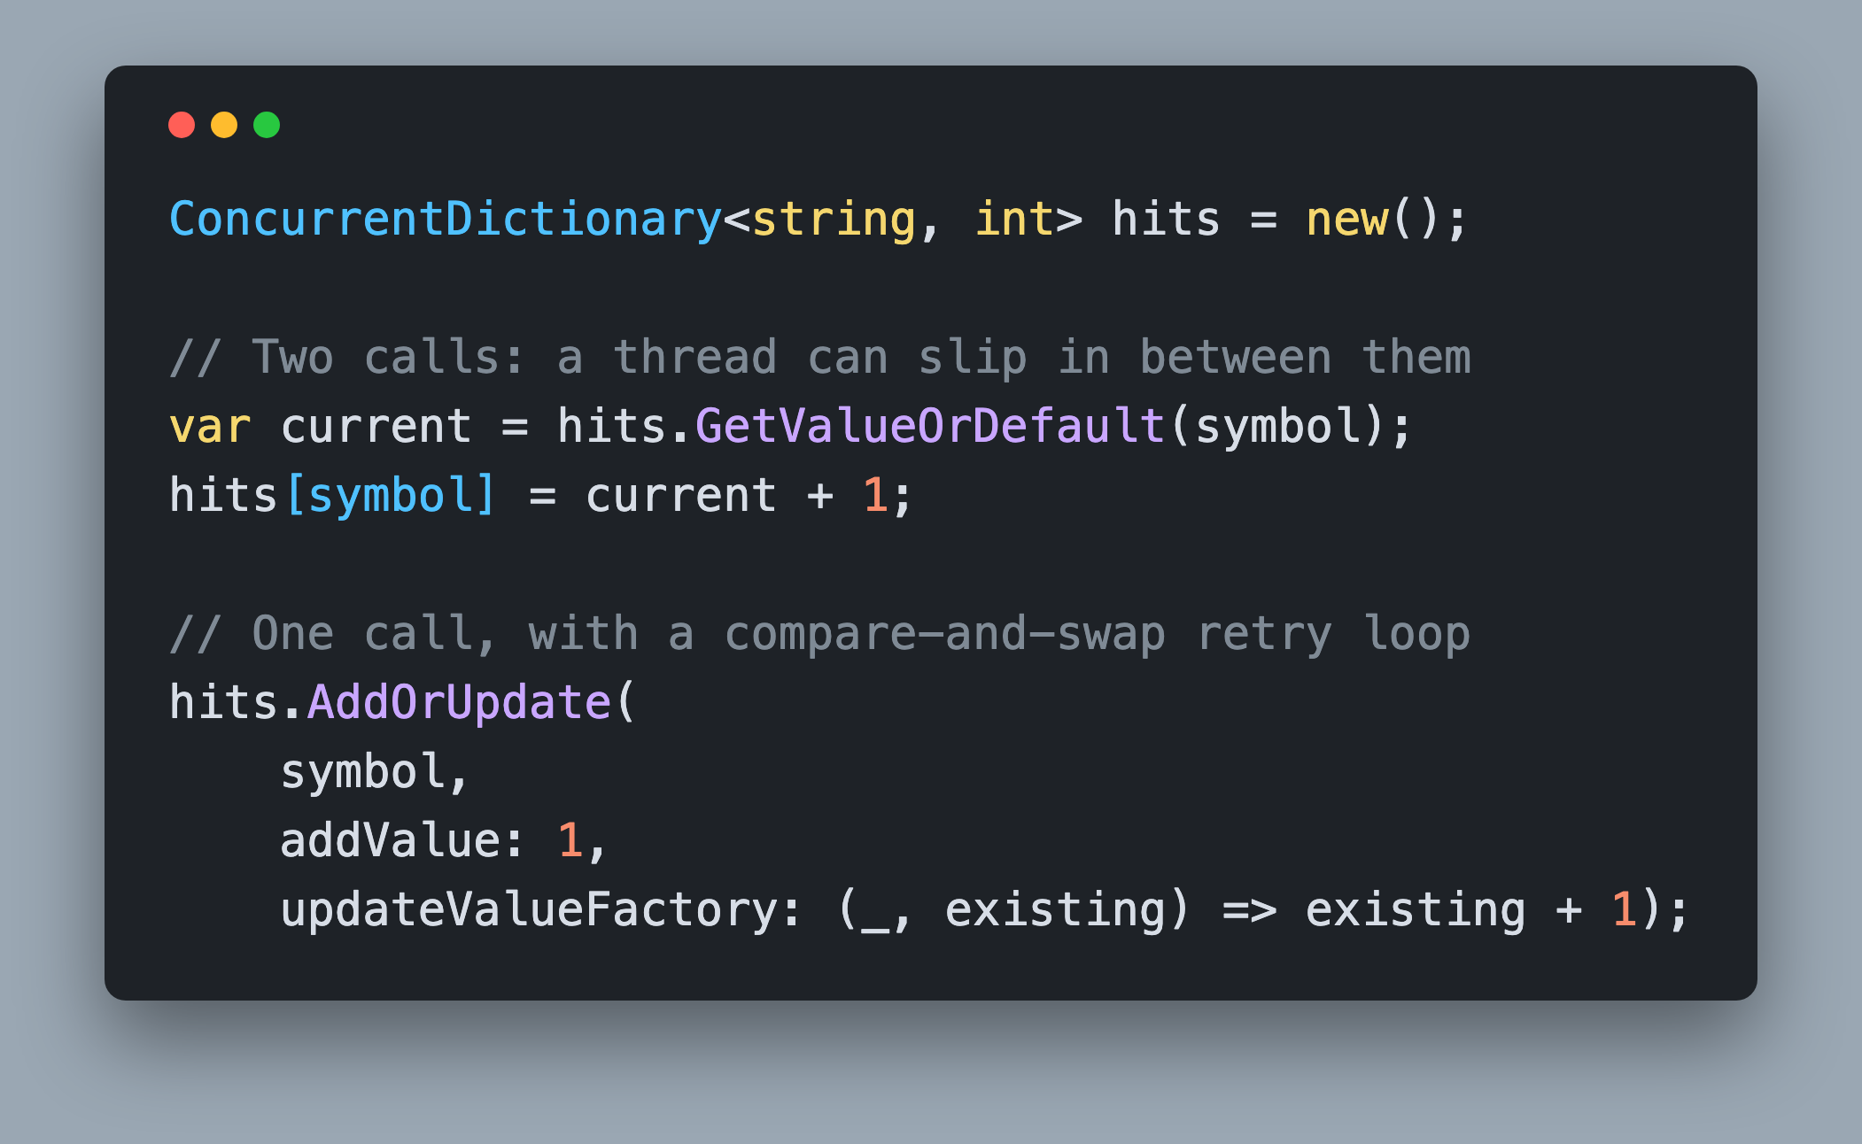
AddOrUpdate() One Call, No Lost Updates
`AddOrUpdate` replaces read, then write
`GetOrAdd` for create once, read many
Both return the value now stored for that key
Notes:
Swapping the type is only half the fix. Look at the first pair of calls. Reading the current value and then writing the new one are two separate operations, and every method being thread safe does nothing to stop another thread from landing between them. You still lose updates.
AddOrUpdate collapses the read, decide and write into one call, but not by holding a lock the whole time. It reads the current value, runs your delegate outside the lock, then takes the lock and swaps the new value in only if nobody changed it while your delegate was running. If somebody did, it throws your result away and tries again.
No update is lost, but your delegate can run more than once, which is exactly what the next slide is about.
You give it the key, the value to use when the key is missing, and a delegate that turns the existing value into the new one. GetOrAdd is the sibling you want for create once and read many, which is the shape of most caches.
https://learn.microsoft.com/dotnet/api/system.collections.concurrent.concurrentdictionary-2.addorupdate

Slide 7
Thread Safe Is Not Atomic GetOrAdd() and AddOrUpdate()
Thread safe
But not atomic
Your delegate runs outside the internal lock
Ensures that unknown code cannot block other threads
It can be invoked more than once under contention
`GetOrAdd` can hand you another thread's value
Notes:
This is the caveat that catches experienced developers, and it is written into the documentation for a reason. All methods on ConcurrentDictionary are thread safe. Not all of them are atomic, and GetOrAdd and AddOrUpdate are the two that are not.
The delegate you pass in is deliberately invoked outside the dictionary's internal lock. If it ran inside, one slow or badly behaved factory would block every thread touching that stripe of buckets.
The tradeoff is that under contention your factory can run more than once, and the value GetOrAdd returns is not guaranteed to be the one your own factory created. Another thread may have won the race, and you get their instance.
So keep those delegates pure, cheap and side effect free. Comparing two timestamps and returning the winner is perfect. Opening a database connection or sending an email in there is a bug waiting for a busy Tuesday.

Slide 8
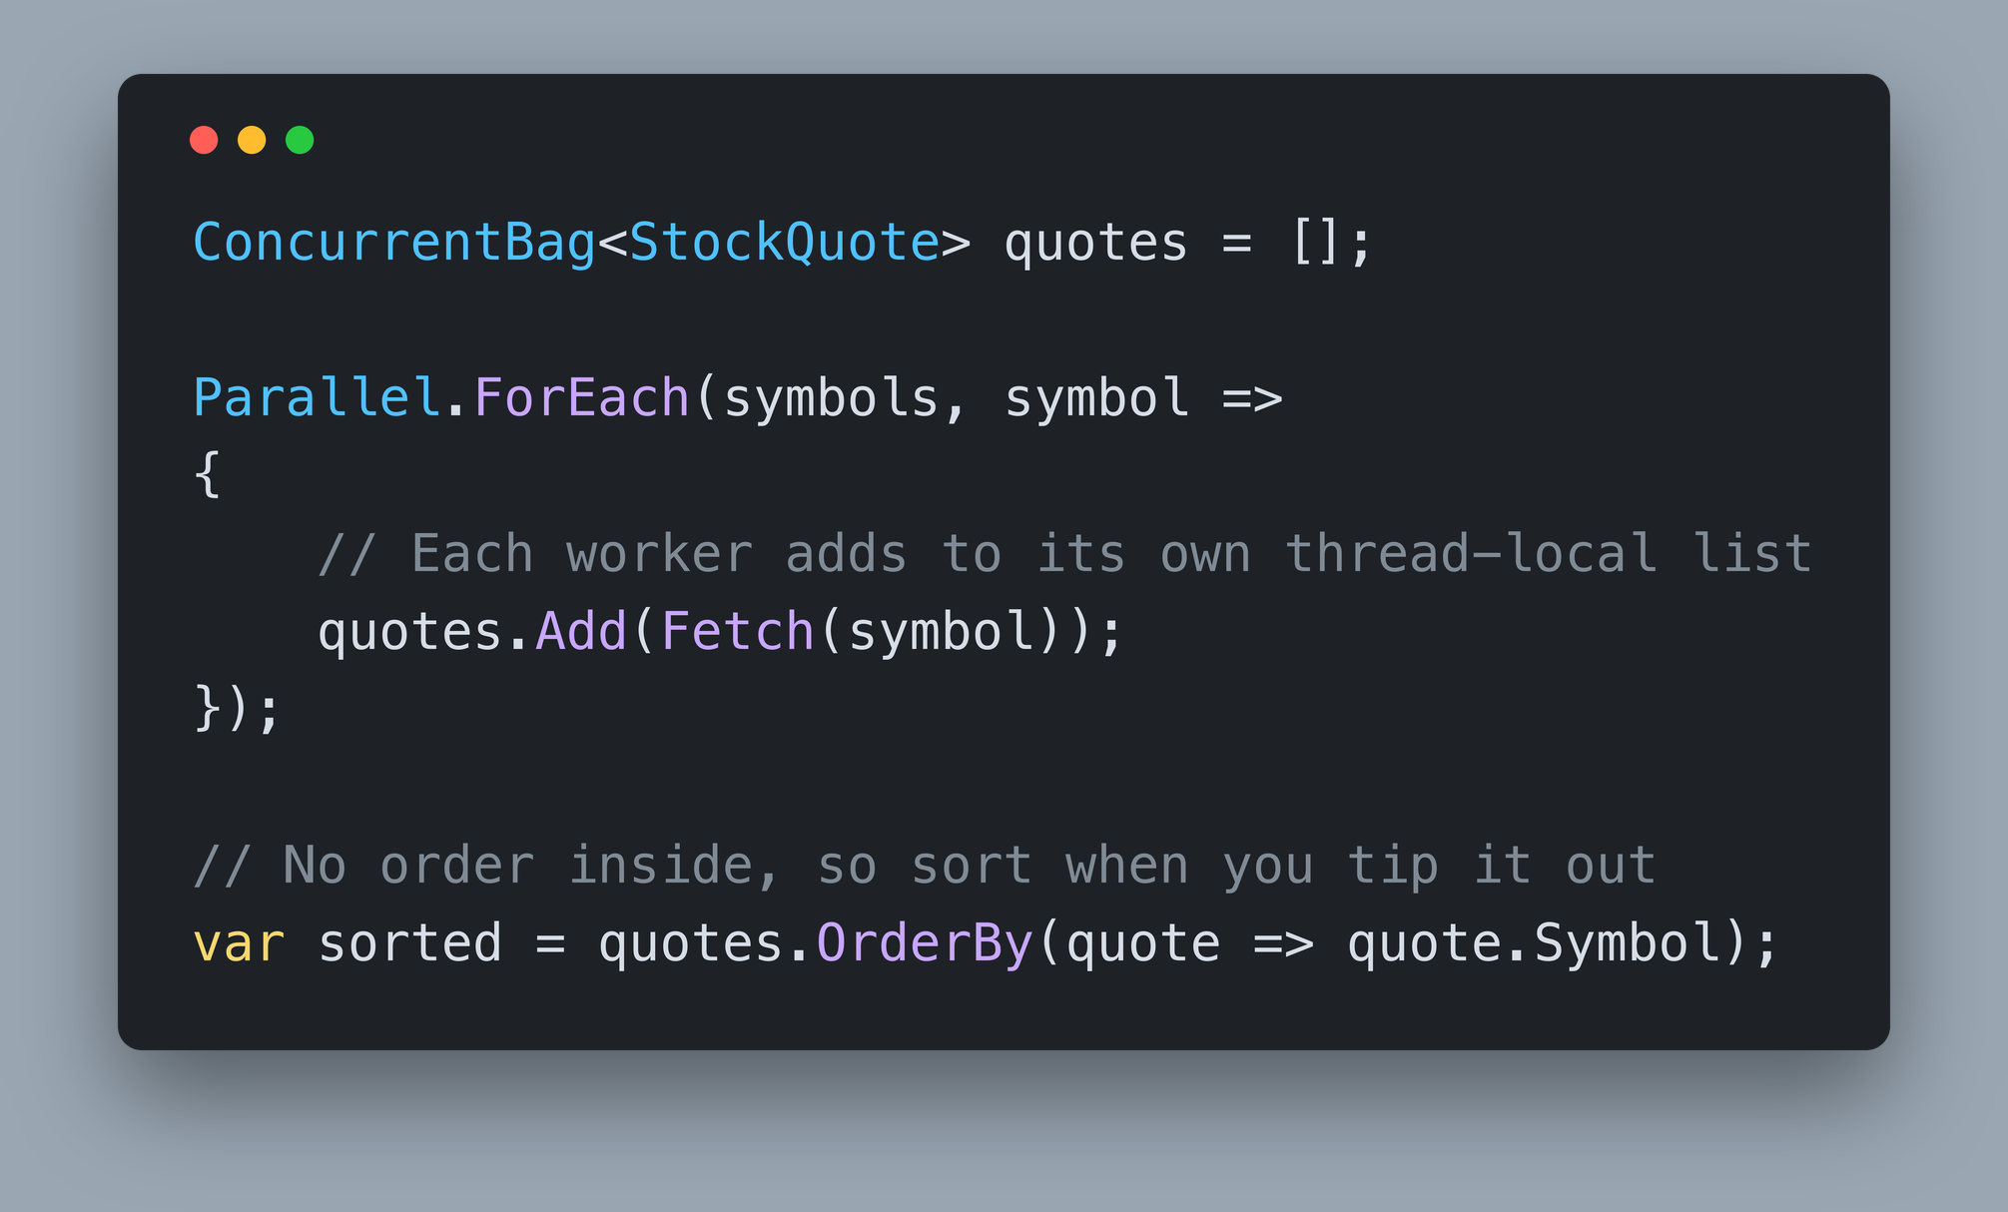
ConcurrentBag<T> System.Collections.Concurrent
Thread-safe, unordered collection of objects
Allows Duplicates
No index, no key, no order
Built for collecting results from parallel workers
Each thread gets its own local list
Notes:
In programming, a bag, also known as a multiset, is an unordered structure that stores a collection of items where duplicates are allowed. Unlike a set, which only stores unique elements, a bag focuses on simply collecting items regardless of their order or frequency.
It is a grocery bag. Things go in, and you can tip it out later.
That is exactly the shape of a parallel loop that produces results. Every worker has an answer, nobody cares what order the answers arrive in, and you sort or aggregate at the end.
The implementation is what makes it fast. Each thread gets its own local list, so adding usually contends with nobody at all. When a thread tries to take an item and its own list is empty, it steals from another thread's list.
That is why a bag is excellent when the same threads both add and take, and merely fine otherwise.
https://learn.microsoft.com/dotnet/api/system.collections.concurrent.concurrentbag-1

Slide 9
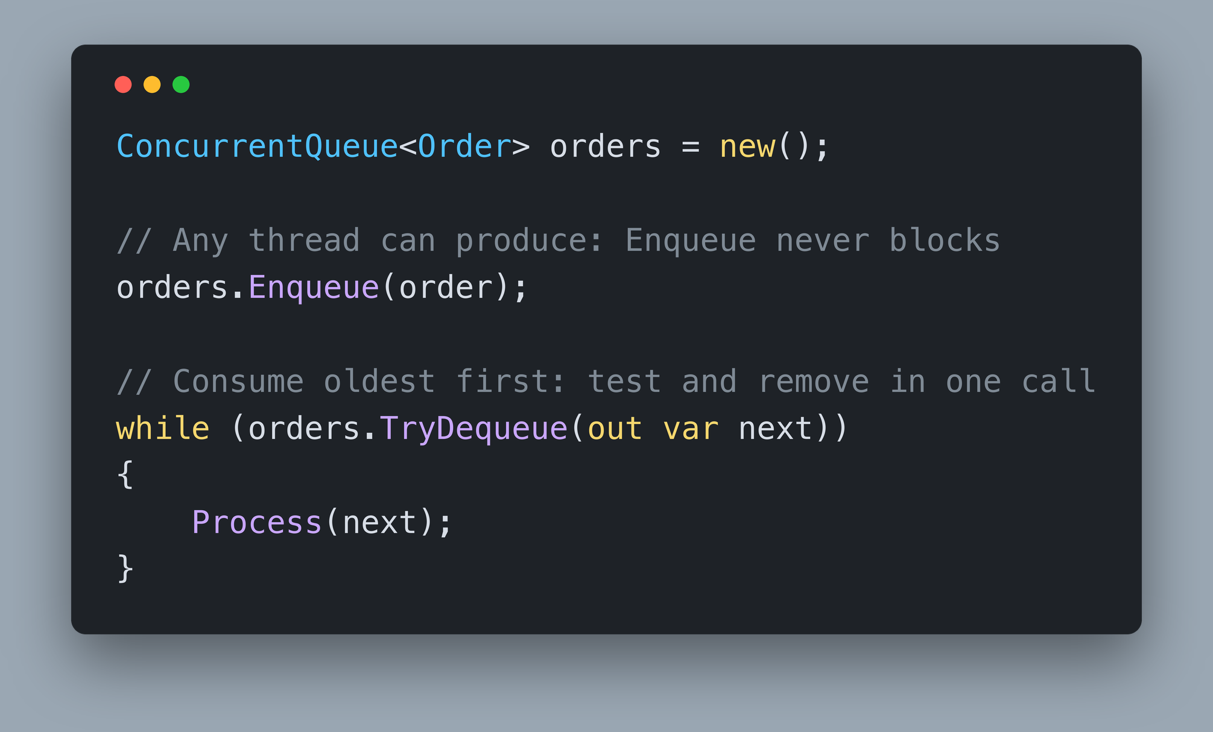
ConcurrentQueue<T> System.Collections.Concurrent
Thread-safe, first in-first out (FIFO) collection
Replaces `Queue<T>`
Lock-free on the common path
Takes a lock only to add or retire a segment
`Enqueue`, `TryDequeue`, `TryPeek`
One end for the producer, the other for the consumer
Notes:
ConcurrentQueue replaces Queue and keeps first in, first out ordering. It is built on linked segments of items, and enqueuing or dequeuing within a segment is a lock-free compare-and-swap, so threads almost never wait on each other.
It does hold one internal lock, but only when it has to grow onto a new segment or retire an exhausted one, and for Clear and Count.
The shape it fits is a producer on one end and a consumer on the other. Work arrives, work gets picked up in the order it arrived, and fairness matters. That covers a lot of real systems: job queues, request buffers, anything where the oldest item deserves attention first.
Note TryDequeue rather than Dequeue. In a concurrent queue there is no safe way to ask whether the queue is empty and then remove an item, because the answer can change between the two calls. Try does both in one step and tells you whether it worked.
Remember this type when we reach Channels in the next section. An unbounded channel is a ConcurrentQueue with signalling on top.
https://learn.microsoft.com/dotnet/api/system.collections.concurrent.concurrentqueue-1

Slide 10
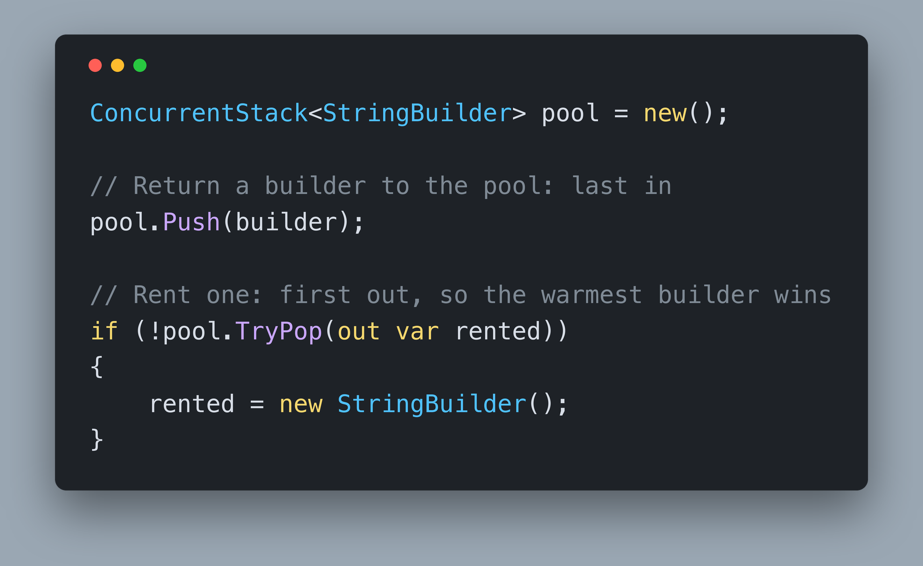
ConcurrentStack<T> System.Collections.Concurrent
Thread-safe, last in-first out (LIFO) collection
Replaces `Stack<T>`
Fully lock-free
Uses `Interlocked.CompareExchange`
`Push`, `TryPop`, `TryPopRange`
Notes:
ConcurrentStack replaces Stack and keeps last in, first out ordering. It is the easiest of the four to reason about: a stack is just a linked list with a head pointer, and every push and pop is an Interlocked.CompareExchange on that head.
Read your value, compute the new head, and swap it in only if nobody moved it while you were thinking. If someone did, loop and try again. There is no lock anywhere in that story, which is why this one really is fully lock-free.
TryPopRange is worth knowing. It pops several items in one operation, which is a real win when many threads are hammering the same head pointer, because it amortizes the contention.
Be honest about when you want LIFO, though. It means the newest work gets served first and the oldest item can sit there forever. That is right for a cache of reusable objects, where the most recently returned one is the warmest, and wrong for almost every work queue.
https://learn.microsoft.com/dotnet/api/system.collections.concurrent.concurrentstack-1

Slide 11
Thread Safe Per Call Only
Two safe calls in a row are still a race
Notes:
This is the sentence to write on a sticky note. A concurrent collection guarantees that each individual call is safe. It guarantees nothing about two calls in a row.
TryGetValue followed by an indexer assignment is a race. Checking Count and then removing an item is a race. TryAdd, and then falling back to the indexer when it returns false, is a race, and that last one is sitting in the starter project right now.
The fix is always the same in shape: find the single method that does the whole thing, or wrap the sequence in something that gives you exclusive access. AddOrUpdate and GetOrAdd exist precisely so you do not have to invent that yourself.
The same rule applies to everything else in your class. Swapping a Dictionary for a ConcurrentDictionary does nothing for the plain int counter next to it, and nothing for the single field two async methods both want to write. That is the rest of this section.

Slide 12
Challenge: Make the Dashboard Thread Safe 25 Minutes
`8. Concurrent Collections/1. Start/StockWatch`
Run it first. Count the cards. Watch the tile.
Five `// ToDo Refactor` comments, all in one file
Goal: 60 of 60 cards, on every render
The compiler will not help you here
*AI Agents are for understanding, not for solving
Notes:
Your turn. Open the starter project, run it on localhost port 5005, and before you change a single line, look at it.
Count the cards in the grid. Watch the quotes applied tile. Reload the page half a dozen times and notice that you get a different answer almost every time. That unpredictability is the symptom you are fixing.
Everything you need to change is in Dashboard.razor.cs, marked with five ToDo Refactor comments. Two of them are the collection types themselves. One is a read followed by a write on that dictionary. One is the counter increment. One is the timer field that two async methods both write.
There is a sixth change that carries no ToDo comment at all: how that counter is read back. Finding it is part of the exercise.
You have 25 minutes. Aim for 60 cards on the first paint and on every refresh after it, and a counter that climbs by exactly 60 every 2 seconds.
AI Agents are for understanding, not for solving. You're smart. You got this.

